Slide 1
Deploying OpenStack
In a Multi-Hypervisor Enterprise Environment
Rick Ashford
Senior Technical Specialist
rashford@suse.com

Slide 2
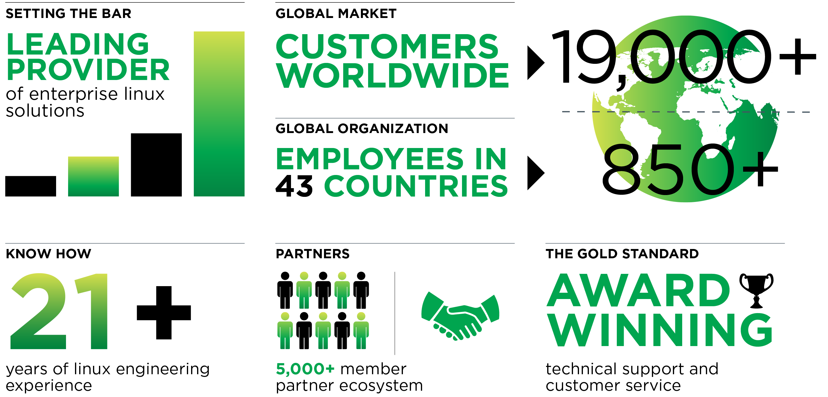
21 Years of Adapting Open Source
Notes:
SUSE is a leading provider of Linux-based solutions for the enterprise
Over 13,000 customers today are supported by a global organization - over 700 employees in 43 countries
We are not new to the Linux market. As an organization, SUSE has been commercializing open source software for over 20 years
What we are known for (and proud of) is our extensive partner and ISV ecosystem, and the award-winning support we consistently provide to our customers.

Slide 3
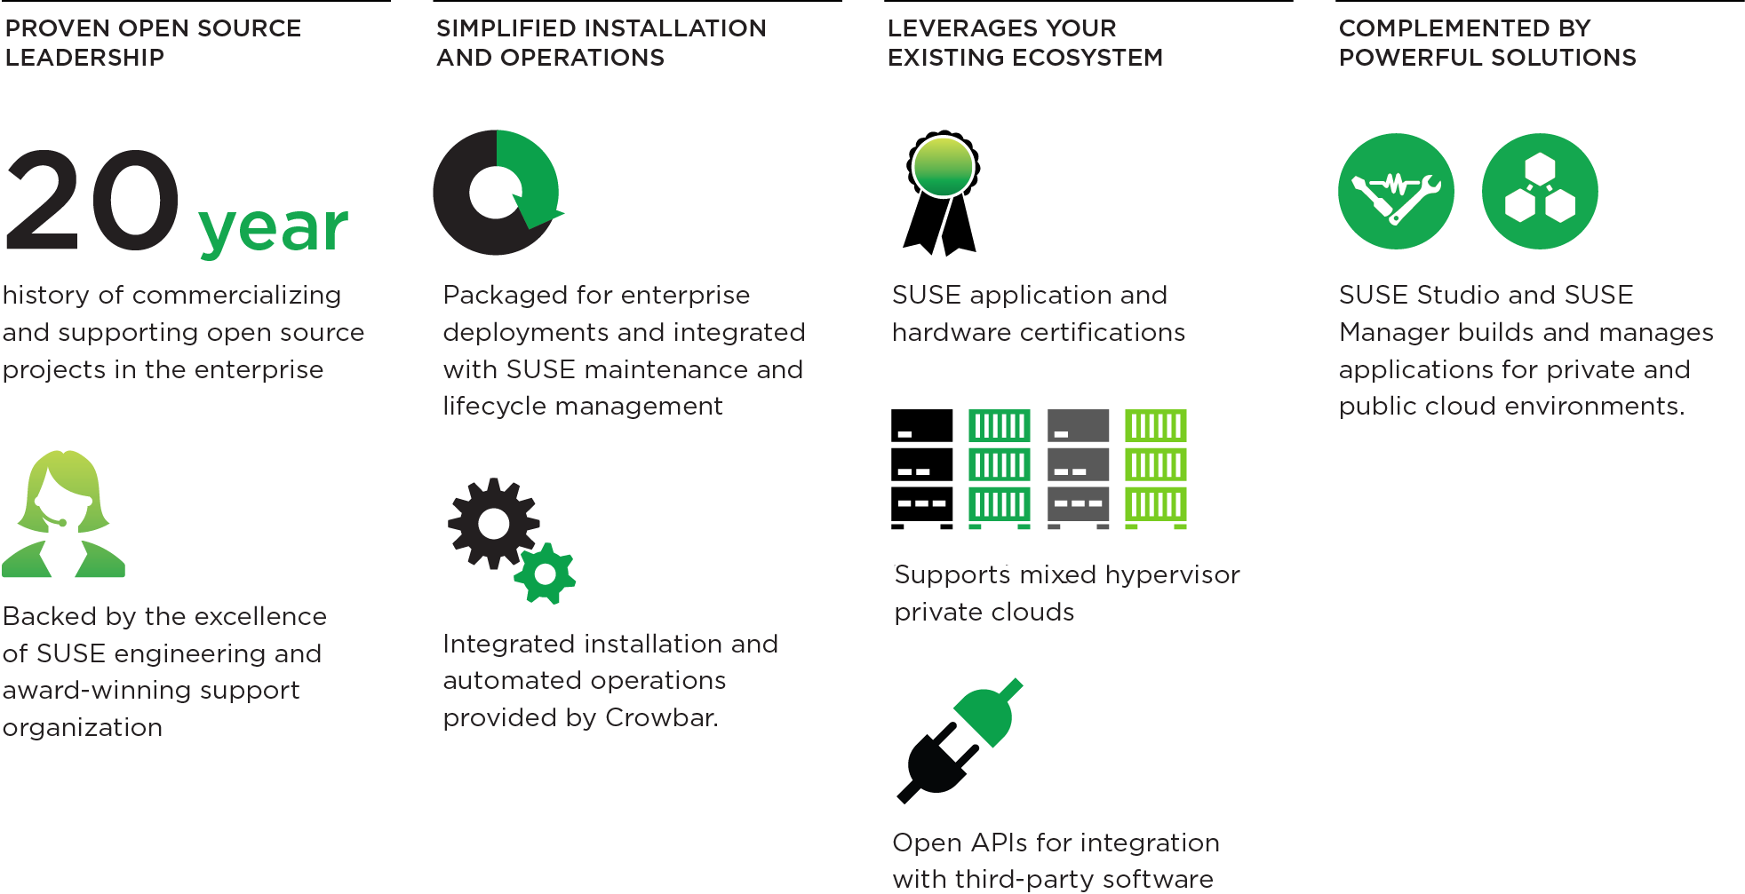
Why SUSE Cloud?

Slide 4

SUSE Cloud 3 Highlights
Based on OpenStack Havana
  Orchestration module (Heat) project for
  VM orchestration
  Telemetry module (Ceilometer) improves
  cloud measurement
New Features
  Full VMware support
  Improved networking and block storage adapter support
    Cisco Nexus, EMC, VMware NVP and others
  Updated Ceph packages
  SUSE Cloud 2 to SUSE Cloud 3 upgrade
  Manual addition of existing servers as cloud nodes
Platform for High Availability
  Delivered as update in March

Slide 5
What's the Problem?

Slide 6


Enterprises Fear Change
Cloud computing
represents a
fundamental change
to IT processes

Slide 7




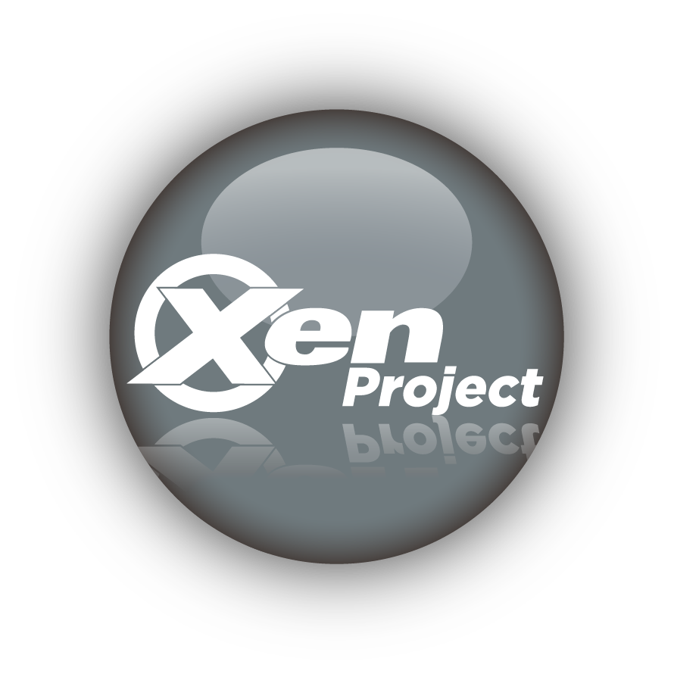
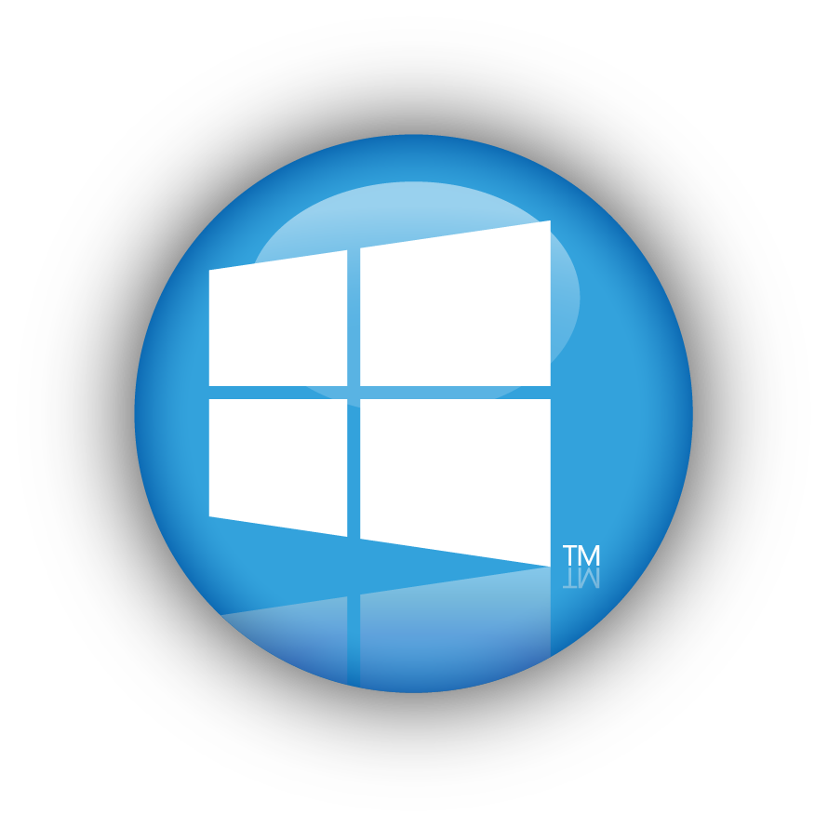

Enterprises Fear Change
Large investments have already been made
in existing virtualization infrastructure
Investment in skilled employees
Training investment
Lack of familiarity with open-source hypervisors
Vast majority of VMware administrators are Windows users
Disaster-recovery infrastructure and procedures

Slide 8
What do Enterprises Need?

Slide 9

Ideally it's all the same...

Slide 10

What Do They Need?
No data center is homogeneous
VMware has ~56% of the market
Hyper-V is growing rapidly, but not necessarily at the expense
of VMware

Slide 11

What Do They Need?
Cloud computing platform needs to be agnostic

Slide 12


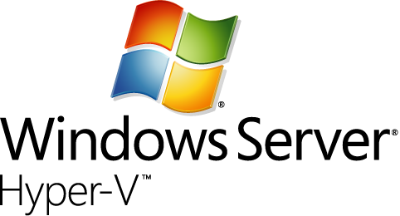
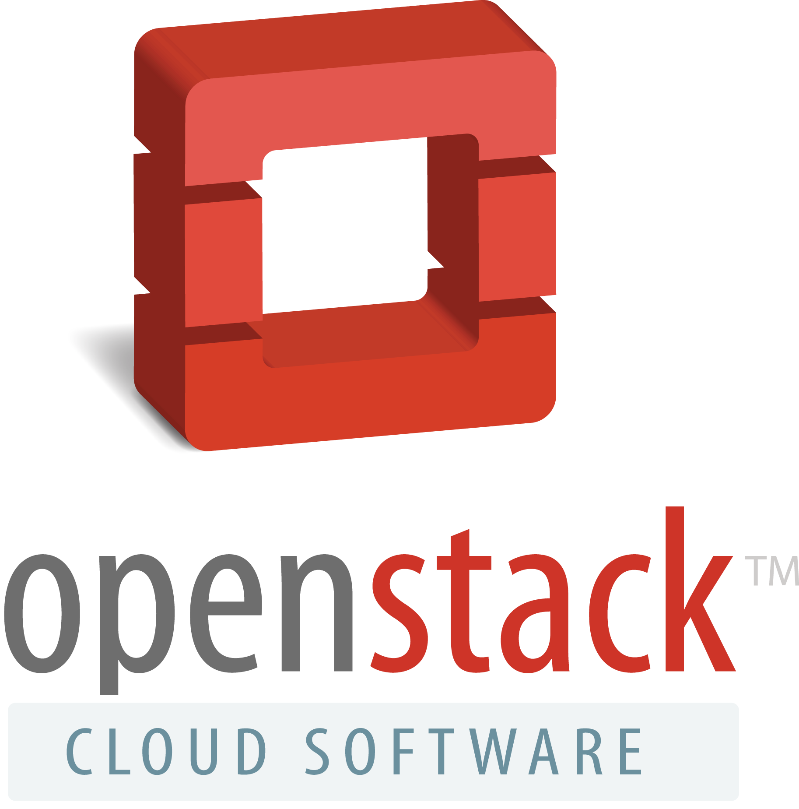
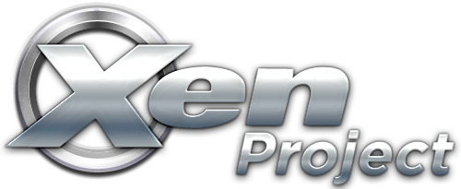


Slide 13
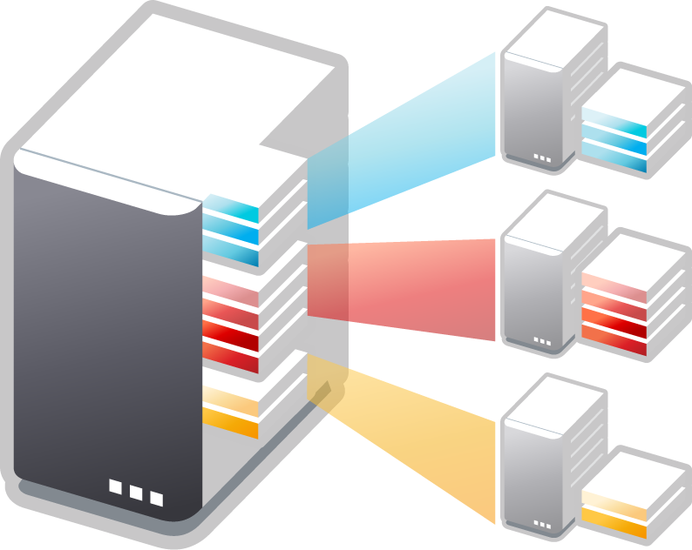


Mixed Hypervisor Support Matters
Advantages of running multiple hypervisors
  Workload optimization
  Licensing flexibility
Cloud can simplify heterogeneity
  Single control plane
  Schedule on any server

Slide 14
How Can I Make it Happen?

Slide 15
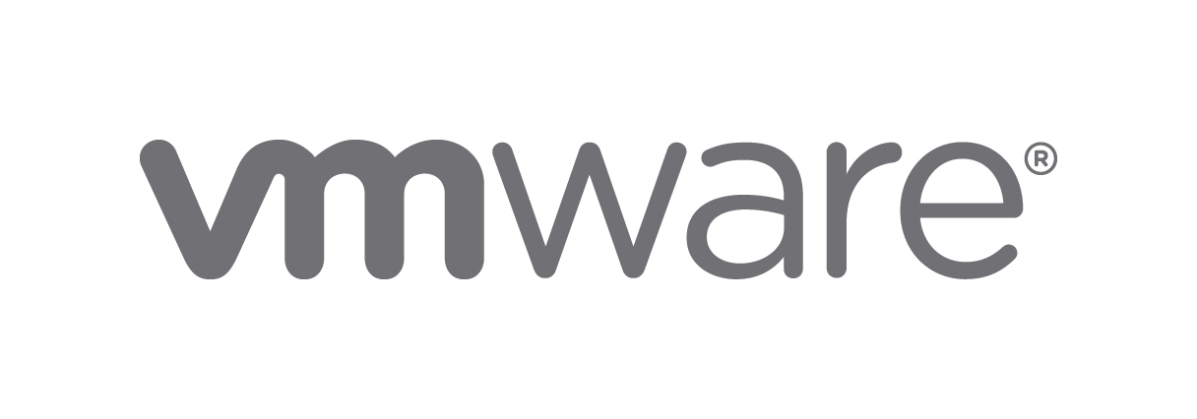
How Do I Do It?

Slide 16

How Do I Do It?
VMware driver added to OpenStack as of Grizzly
Please don't use that!
Major upgrade to driver in Havana
Compute node dedicated to communicating with vSphere
VMware NSX plug-in for Neutron
Cluster or clusters in vSphere dedicated to OpenStack virtual machines
Bridge interface on hosts for VLAN traffic

Slide 17

Limitations
No iptables = no security groups
Havana—No Cinder support (EULA limitations)
Icehouse has new VMDK driver for Cinder
No live migration (from OpenStack)

Slide 18
How Do I Do It?

Slide 19
How Do I Do It?
Hyper-V driver usable as of Grizzly
Setup virtual switching
Enable iSCSI initiator service
Configure Shared-Nothing Live Migration
Install Nova-Compute

Slide 20
Limitations
No iptables = no security groups
No serial/VNC console—Must use RDP
Vlan and Routing is only supported on Hyper-V when using the Quantum / Neutron Hyper-V Agent

Slide 21
How Do I Do It?

Slide 22

How Do I Do It?

Slide 23

How Do I Do It?

Slide 24
Image Properties
glance image-create \
--name=”Foo-<version>-<format>” \
--is-public=True \
--disk-format=<format> \
--container-format=bare \
--property hypervisor_type=”<hypervisor>” \
[ --property vmware_adaptertype=lsiLogic ] \
[ --property vmware_disktype=preallocated ]

Slide 25
Image Properties
If creating a VMware image, you may need to use Virtual Disk Manager to convert to an ESX-compatible format
vmware-vdiskmanager \
-r <vmdk file> \
-t 4 <new file>

Slide 26
It's SHOWTIME!
Notes:
Demonstration digging into the details of OpenStack. The nova and glance cli's

